Slide 1

Automated Drink Ordering and Billing System
Complex Computing Project (CCP) | Programming Fundamentals CT-175
Group Members: Laiba Qureshi (CT-25154)
Fatima Nasir (CT-25155)
Rateeba Ahmed (CT-25173)
Instructor: Mr. Muhammad Abdullah

Slide 2
Project Abstract
This project... is a simple C program that simulates a café's ordering and billing process. It allows the user to select a drink, choose its size, and add an optional sweet item. The program uses arrays to store menu items and their corresponding prices, making it easier to manage... It also employs switch statements to handle user selections efficiently. The program calculates the total bill, including a 10% tax, and displays a clear order summary.
"
"
— Project Overview

Slide 3

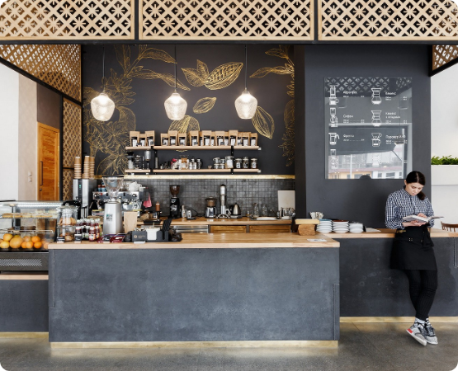
Project Description
Simulating Real-World Operations
The Café Billing System is a console-based application developed in C, designed to simulate the real-world operations of a café, including order placement and bill generation.
Arrays are used to store menu items and their respective prices, which simplifies management and enables easy updates to the menu.
By incorporating conditional statements and arithmetic operations, the program calculates the subtotal, applies a fixed 10% tax rate, and provides the final total bill, reducing the human errors found in manual billing.

Slide 4
Project Methodology
Exploring the 'how': from data and tools to the core algorithm.

Slide 5


Dataset and Tools
Dataset / Input Data
Tools & Technologies
•
Drink Names (Spanish Latte, etc.)
•
Language: C Programming
•
Drink Prices & Temperature Charges
•
IDE: Dev C++
•
Size Options (Small, Medium, Large)
•
Platform: Windows OS
•
Sweet Add-ons (Lemon Tart, etc.)
•
Compiler: GCC
•
Tax Rate (10%)

Slide 6
Algorithm / Pseudocode
2. INPUT
4. CALCULATE & END
Get user choices (drinkChoice, tempChoice, sizeChoice, sweetChoice).
Calculate total, apply tax, and display the final Order Summary.
1. START
3. VALIDATE
Display Welcome message and all menus (Drink, Temp, Size, Sweet).
If any input is invalid, set a default (e.g., Small, Hot, No Sweet).

Slide 7






Objectives & Goals
Objectives
Goals
Simulation
To automate café billing operations and generate accurate bills, including a full tax and itemized breakdown.
To apply programming fundamentals and demonstrate proficiency in C (arrays, switch statements, and loops).
To simulate a real-world ordering process in a simple, structured, and user-friendly console format.

Slide 8
Expected Outcomes
A functional console-based Cafe Billing System that accurately performs ordering and billing operations.
A system that allows users to select drinks, sizes, and sweet add-ons using simple numeric inputs.
Automated calculation of total bills, including tax, without human intervention.
A clear, itemized order summary displayed with each selected option and its corresponding price.
A simple and user-friendly interface that ensures smooth interaction and prevents crashes from invalid input.

Slide 9
Code Implementation
A look at the C code structure and core logic.

Slide 10
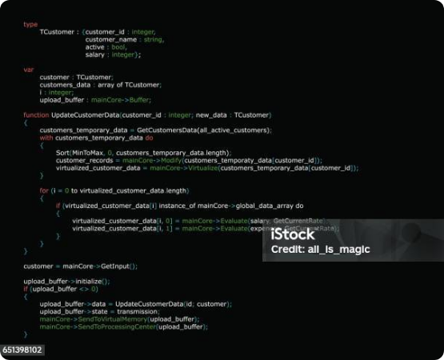
Code Explanation: Key Concepts
•
Arrays: char drinks[4][40] and float drinkPrices[4] store menu items and costs.
•
Input/Validation: scanf gets user choice. if (choice < 1 || choice > 4) checks validity and sets a default.
•
Calculation: total = drinkPrice + sizePrice + .... tax = total * TAX_RATE.
•
Constants: const float TAX_RATE = 0.10; ensures the 10% tax rate is fixed and cannot be accidentally modified.
•
Output: printf is used to format and display the final "ORDER SUMMARY" in a clean, readable format.

Slide 11
Errors Encountered: Key C Implementation Challenges
1. Off-by-One Array Access
Problem: C arrays start at index 0, but our user-facing menu needed to start at choice 1.
Mistake: Our initial code tried to access the array directly with the user's choice, like `drinkPrices[choice]`.
Consequence: This led to **Program Crashes** (Segmentation Fault) or reading garbage memory when a user selected the last item.
The Fix: We enforced a consistent rule to always access arrays using `[choice - 1]` to map the user's input to the correct index.
2. Logical vs. Bitwise Operators
Problem: We needed to validate if a user's input was outside the allowed range (e.g., less than 1 OR greater than 4).
Mistake: We accidentally used the **Bitwise OR (`|`)** operator instead of the **Logical OR (`||`)** o
Consequence: This is technically incorrect logic. It doesn't perform "short-circuiting" and could lead to unstable validation.
The Fix: We corrected all validation logic to use the proper Logical OR (`||`) operator for all boolean checks.

Slide 12



Future Enhancements
Multi-Order
Database
New Interface
Implement functionality to handle multiple orders simultaneously for different customers.
Connect the system to a database (MySQL or SQLite) to store daily orders, total sales, and order history.
Transform the console program into an interactive website (HTML/CSS) or add file handling for saving receipts.

Slide 13
Conclusion
The Cafe Billing System project successfully demonstrates the use of arrays, switch statements, and arithmetic operations to automate billing. It simplifies manual tasks, ensures accurate price computation, and reinforces basic concepts of user interaction and modular code design. This project serves as a foundational step toward developing more advanced and feature-rich commercial applications.
Thank You

